Slide 1

Design and Development of English to Telugu Translation System based on Transformer with Deep Learning
Team
Dr Khelchandra Thongam
Associate Professor
Computer Science and Engineering Dept.
Supervised By
Jayanth Reddy G (20103010)
Akhila Banothu (20103052)

Slide 2
Introduction
Methodology
Results
Timeline
Conclusion and Future Work
Literature Survey
References
CONTENTS

Slide 3

INTRODUCTION

Slide 4
AIM
This project aims to create a proficient English to Telugu translation system using transformer architectures in deep learning. By bridging language gaps, it enhances communication and accessibility, offering an advanced tool for seamless translation between English and Telugu.

Slide 5
OBJECTIVES
Implement a transformer-based deep learning model for text translation.
Fine-tune the model to handle language-specific nuances and improve performance.
Implement appropriate evaluation metrics (e.g.,BLEU-score, accuracy)to quantitatively assess the translation quality.
Create an intuitive and user-friendly interface

Slide 6
MOTIVATION
Our project, aiming to create an English to Telugu transformer-based translation system, is fueled by the commitment to empower the Telugu-speaking community. By breaking language barriers, this initiative provides seamless access to global information, education, and diverse perspectives, allowing the Telugu community to express themselves on a broader stage.
This transformative tool not only translates words but preserves the cultural nuances of Telugu, fostering cross-cultural communication and understanding.

Slide 7
SCOPE
Language-specific Challenges: Address Telugu's linguistic nuances to ensure contextually accurate translations.
User Interface Design: Develop an intuitive interface for seamless English to Telugu text translation.
Real-time Translation: Strive for real-time translation capabilities to enhance user experience.
Cross-Platform Compatibility: Ensure the system is compatible across various platforms and devices.
Scalability: Design the system to be scalable for potential expansion to additional languages or model enhancements.

Slide 8

LITERATURE SURVEY

Slide 9
SURVEY - 1
Rule-Based Machine Translation (RBMT):
RBMT relies on explicit linguistic rules and grammatical structures to translate text from one language to another. These rules are typically created by linguists and translation experts and may involve syntax, semantics, and morphology.
RBMT systems heavily depend on linguistic knowledge and require extensive manual rule creation. Linguists need to encode language specific rules and translation patterns, making the process labor-intensive.
Transformer-Based Approach:
Transformer models learn translation patterns directly from large parallel corpora without explicit rule definition. They are trained on vast amounts of data, allowing them to generalize well across various language pairs and contexts.
Unlike RBMT, transformer-based systems follow an end-to-end learning approach. They automatically learn hierarchical representations of input sentences and generate translations without relying on predefined linguistic rules.
Reference : English to Telugu Rule based Machine Translation System: A Hybrid Approach by
Keerthi Lingam, Srujana Inturi, E. Ramalakshmi Assistant Professors Department of IT CBIT, India
International Journal of Computer Applications (0975 – 8887) Volume 101– No.2, September 2014

Slide 10
SURVEY - 2
LSTM (Long Short-Term Memory):
LSTMs are based on recurrent neural networks (RNNs) and process input sequences sequentially. They maintain hidden states that capture information from previous time steps, allowing them to model temporal dependencies.
LSTMs have hidden states and memory cells that enable them to capture and store information over long sequences. The memory cells help in mitigating the vanishing gradient problem associated with standard RNNs.
Transformer-Based Approach:
The Transformer architecture relies on attention mechanisms, allowing it to capture relationships between words in a sequence in a parallelized manner. This attention mechanism allows each position in the input sequence to focus on different parts of the input sequence during processing.
Transformers are highly parallelizable, making them computationally efficient. The attention mechanism allows for simultaneous processing of all positions in a sequence, enabling effective use of hardware accelerators like GPUs.
Reference : Neural Machine Translation System for English to Indian Language Translation Using MTIL Parallel Corpus
by B. Premjith, M. Anand Kumar and K.P. Soman
Received February 8, 2018; previously published online March 20, 2019.

Slide 11
SURVEY - 3
Statistical Machine Translation (SMT):
SMT relies on a combination of rule-based and statistical methods. It involves the creation of linguistic rules and the estimation of statistical models based on bilingual corpora.
SMT systems require extensive feature engineering, where linguistic experts manually design features and weights to capture translation patterns, word alignments, and other linguistic phenomena.
Transformer-Based Approach:
Transformers leverage self-attention mechanisms, allowing the model to focus on different parts of the input sequence when generating each part of the output sequence. This attention mechanism captures dependencies effectively and enables the model to handle long-range dependencies.
Transformers excel at capturing contextual understanding, as they consider the entire context of a sentence during both training and inference. This enables them to generate translations that are more contextually relevant and coherent.
Reference : A SURVEY ON FORMAL LANGUAGE TRANSLATION (TELUGU - ENGLISH)
by Mrs. P. Swaroopa, Kalakonda Vishnu, Pulipati Akshay, S. Siva Sai Sandip, Vennam Vivek.
2022 JETIR November 2022, Volume 9, Issue 11

Slide 12

METHODOLOGY

Slide 13
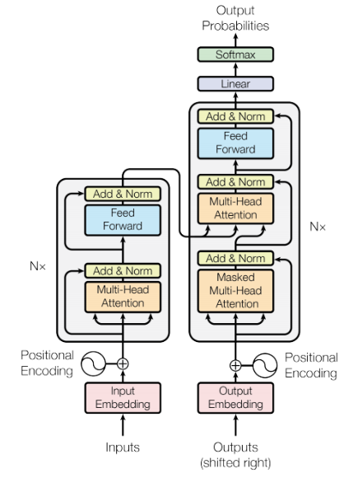
ARCHITECTURE AND FLOW DIAGRAM
Text ( English)
Data Cleaning
Transformer
Custom Tokenizer
Corpus
Vocab file
Output

Slide 14
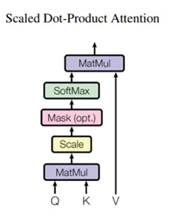
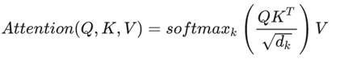
SCALED DOT PRODUCT ATTENTION
The attention function used by the transformer takes three inputs: Q (query), K (key), V (value). The equation used to calculate the attention weights is:
Query vector: Represented by a word vector in the sequence and defines the hidden state of the decoder.
Key vector: Represented by all the words in the sequence and defines the hidden state of the encoder.
Value vector: Represented by all the words in the sequence and defines the attention weights of the encoder hidden states.
The dot-product attention is scaled by a factor of square root of the depth. This is done because for large values of depth, the dot product grows large in magnitude pushing the softmax function where it has small gradients resulting in a very hard softmax.

Slide 15
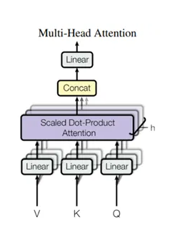
MULTIHEAD ATTENTION
Multi-head attention consists of four parts: Linear layers and split into heads, Scaled dot-product attention, Concatenation of heads, Final linear layer . Each multi-head attention block gets three inputs; Q (query), K (key), V (value). These are put through linear (Dense) layers and split up into multiple heads.
The scaled_dot_product_attention defined above is applied to each head (broadcasted for efficiency). An appropriate mask must be used in the attention step. The attention output for each head is then concatenated and put through a final Dense layer.
Instead of one single attention head, Q, K, and V are split into multiple heads because it allows the model to jointly attend to information from different representation subspaces at different positions. After the split each head has a reduced dimensionality, so the total computation cost is the same as a single head attention with full dimensionality.
This ensures that the words we want to focus on are kept as-is and the irrelevant words are flushed out.

Slide 16
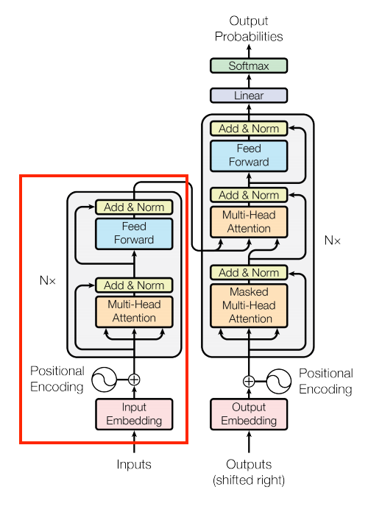
ENCODER
The encoder consists of:
A PositionalEmbedding layer at the input.
A stack of EncoderLayer layers.
The encoder receives the embedding vectors as a list of vectors, each of 512 (can be tuned as a hyper-parameter) size dimension. Both the encoder and the decoder add a positional encoding (that will be explained later) to their input. Both also use a bypass that is called a residual connection followed by an addition of the original input of the sub-layer and another normalization layer (which is also known as a batch normalization)

Slide 17
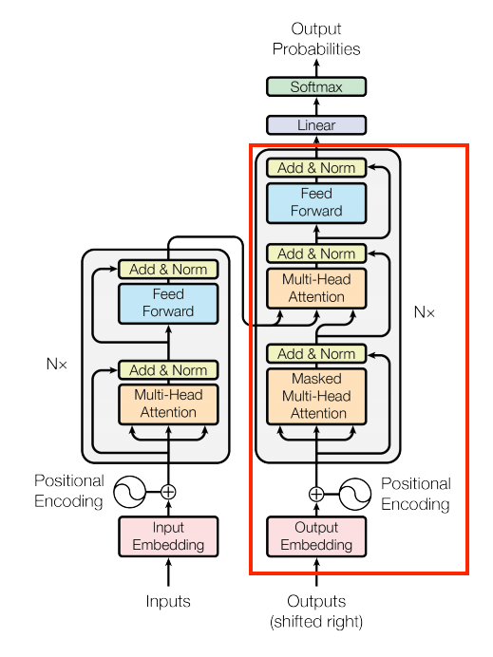
DECODER
The decoder's stack is slightly more complex, with each DecoderLayer containing a CausalSelfAttention, a CrossAttention, and a FeedForward layer
Similar to the Encoder, the Decoder consists of a PositionalEmbedding, and a stack of DecoderLayers
Unlike the encoder, the decoder uses an addition to the Multi-head attention that is called masking. This operation is intended to prevent exposing posterior information from the decoder. It means that in the training level the decoder doesn’t get access to tokens in the target sentence that will reveal the correct answer and will disrupt the learning procedure. It’s really important part in the decoder because if we will not use the masking the model will not learn anything and will just repeat the target sentence.

Slide 18
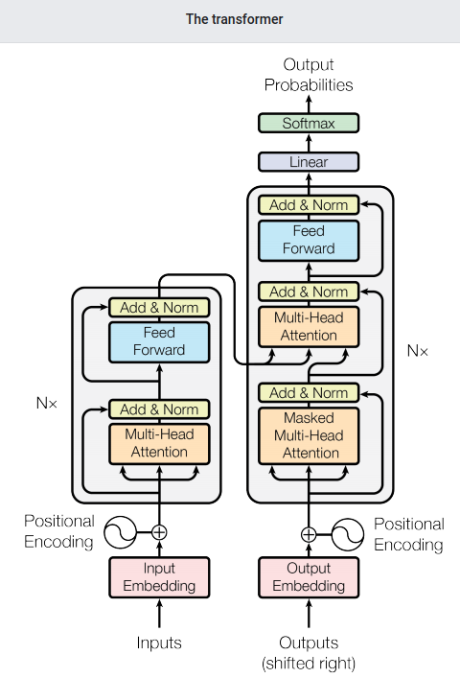
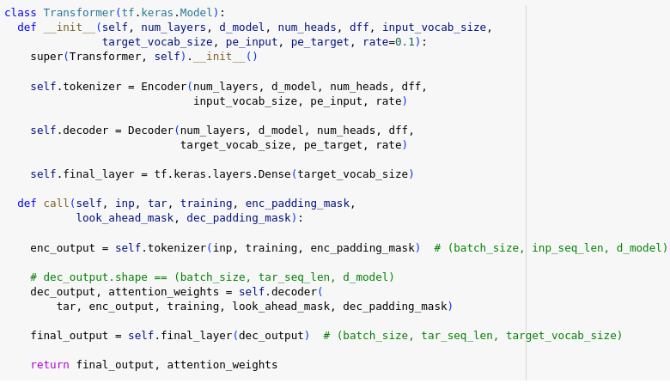
TRANSFORMER
We now have Encoder and Decoder. To complete the Transformer model, we need to put them together and add a final linear (Dense) layer which converts the resulting vector at each location into output token probabilities.
The output of the decoder is the input to this final linear layer.

Slide 19
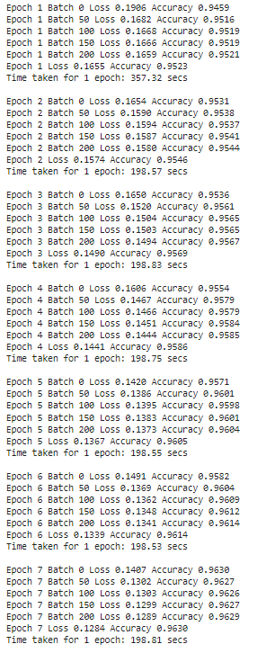
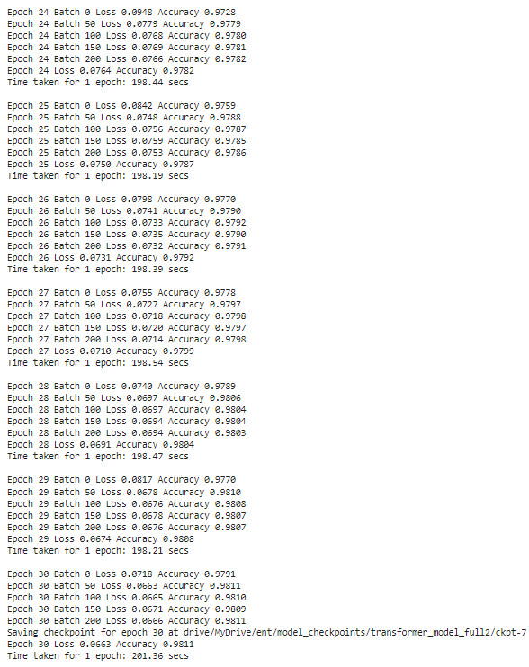
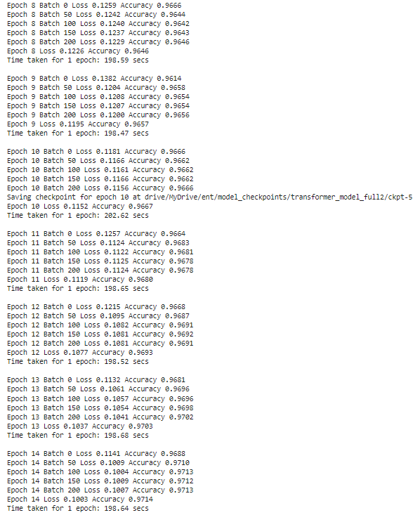
TRAINING
These are the epochs during training
Total of 30 epochs
The last checkpoint is number 7 with loss of 0.0663 and accuracy of 0.9811 (98%)

Slide 20
TRAINING
Achieved accuracy of 98% on training evaluation for 30 epochs

Slide 21
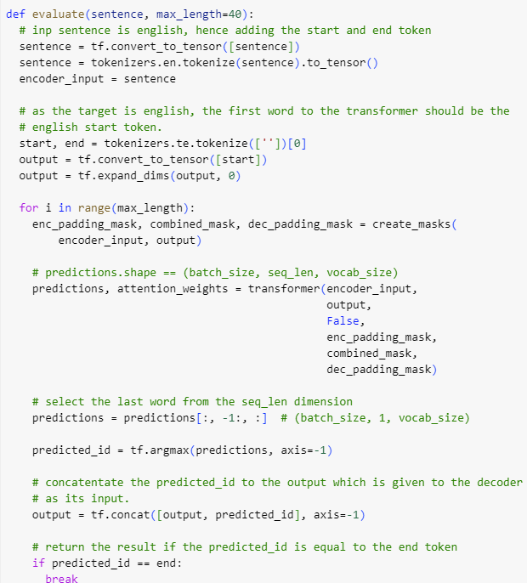
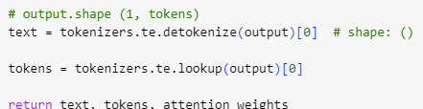
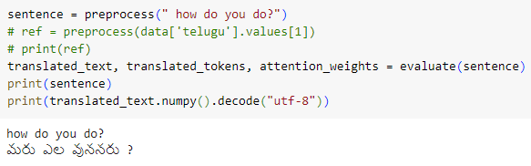
TESTING
Evaluation is done by first preprocessing the input , getting output as text, tokens, weights after predicting using transformer model which is already trained

Slide 22
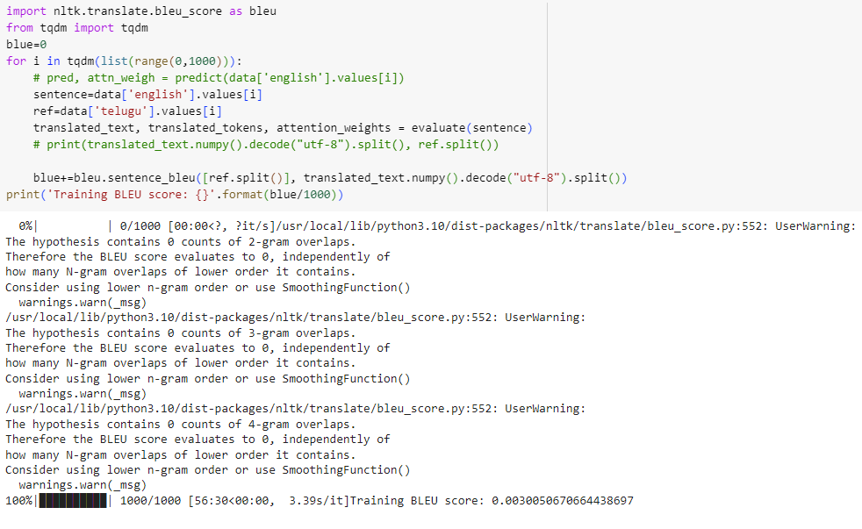
EVALUATION METRICS
The BLEU score compares a sentence against one or more reference sentences and tells how well does the candidate sentence matched the list of reference sentences. It gives an output score between 0 and 1

Slide 23
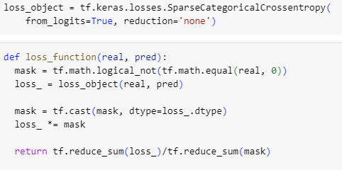
EVALUATION METRICS
tf.keras.losses.SparseCategoricalCrossentropy: This is an implementation of the Sparse Categorical Crossentropy loss function
provided by TensorFlow's Keras API. It's commonly used for multi-class classification tasks where the target labels are integers.
loss_object=tf.keras.losses.SparseCategoricalCrossentropy(from_logits=True, reduction='none'): This line creates an instance of the SparseCategoricalCrossentropy loss function.
from_logits=True: Indicates that the input predictions are not normalized (i.e., they are raw logits) and need to be normalized (e.g., via a softmax activation) before being used in the loss calculation.
reduction='none': Specifies that no reduction should be applied to the individual losses. This means that the loss will be calculated separately for each sample in the batch, rather than being aggregated across the batch.

Slide 24
EVALUATION METRICS
mask = tf.math.logical_not(tf.math.equal(real, 0)): This line creates a mask tensor where elements of real that are equal to 0 are marked as False and all other elements are marked as True. This is typically used to mask out padding elements in sequence data.
loss_ = loss_object(real, pred): This line calculates the loss using the SparseCategoricalCrossentropy loss function created earlier. Since reduction='none', this will return a tensor containing the individual losses
for each sample in the batch.
mask = tf.cast(mask, dtype=loss_.dtype): This line casts the mask tensor to the same data type as the computed loss tensor.
loss_ *= mask: This line applies the mask to the computed loss tensor. This effectively zeros out the loss for padding elements, as they are marked as False in the mask. And at last we calculate mean losses

Slide 25
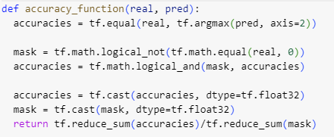
EVALUATION METRICS
tf.equal(real, tf.argmax(pred, axis=2)) returns a tensor where each element is True
if the corresponding element in
real matches the index of the maximum value in the corresponding position of pred, and False otherwise
mask =tf.math.logical_not(tf.math.equal(real, 0)): This creates a boolean mask where True indicates positions where the real values are not equal to 0 (non-padding positions).
tf.math.logical_and(mask, accuracies): Here, the mask is further refined by performing a logical AND operation with the previously computed accuracies. This ensures that only positions where the real values are not padding and the predictions are correct contribute to the accuracy calculation.
accuracies = tf.cast(accuracies, dtype=tf.float32): Converts the boolean tensor of accuracies to float32 data type. This conversion is necessary for subsequent calculations.
mask = tf.cast(mask, dtype=tf.float32): Similarly, converts the boolean mask to float32 data type. This will be used for normalization in the accuracy calculation.
Finally mean accuracy is calculated

Slide 26
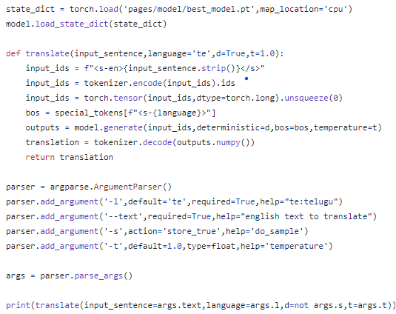
DEPLOYMENT
The implementation involves utilizing a pre-trained transformer model, saved as a pickle file, which is loaded using PyTorch for predicting Telugu text. The process begins by converting the provided input, initially in English, into tokens. These tokens are then utilized as input for the transformer model for prediction.

Slide 27
DEPLOYMENT
The implementation supports command-line arguments for customization. Specifically, the following arguments are utilized:
This implementation allows for seamless integration of language translation functionalities, providing users with a versatile tool for processing multilingual text inputs.
-l: Denotes the language. Presently, the system is configured for Telugu but can be generalized and extended to accommodate other languages.
--text: Represents the input text. Currently, the system accepts English input but can be expanded to support other languages.
-s: Enables sampling.
-t: Represents the temperature parameter, facilitating the generation of diverse contextual outputs.

Slide 28
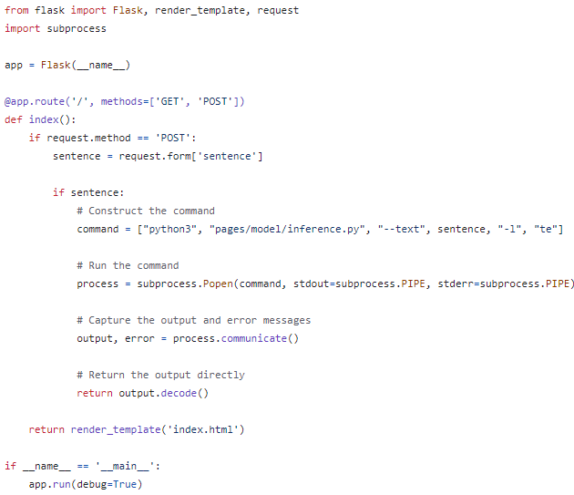
DEPLOYMENT
The deployment strategy involves utilizing Flask to host the application locally. When a POST request is made to the server via a form submission, Flask triggers the execution of a specific command. Subsequently, Flask renders an HTML file to provide a user interface for interaction.

Slide 29

RESULT

Slide 30
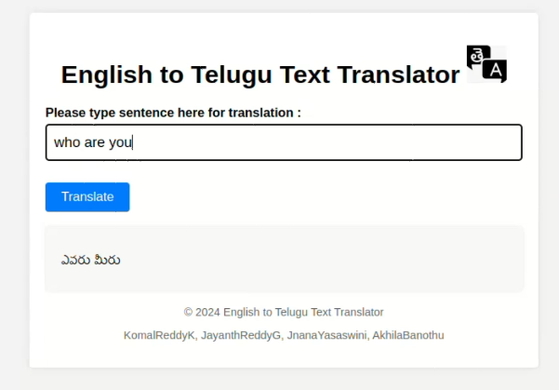
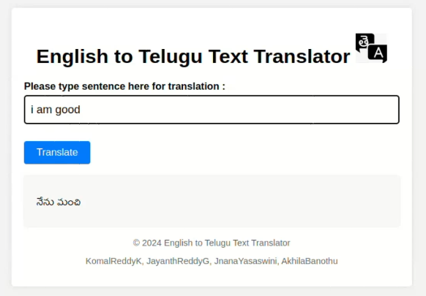

Slide 31
CHALLENGES FACED
BLEU Score Evaluation: One of the challenges faced was ensuring high BLEU (Bilingual Evaluation Understudy) scores, which are critical for assessing the quality of machine-translated text. Achieving a high BLEU score requires the model to produce translations that closely match reference translations, capturing both accuracy and fluency.
Dataset Size and Quality: A significant challenge was the need for large, high-quality parallel corpora to train the Transformer model effectively. Large datasets help the model learn better representations and translations, but collecting and curating such datasets, especially for low-resource languages, was a daunting task.
Training Time: Training the Transformer model took an extensive amount of time, even with powerful hardware. The complexity of the model and the need for processing large datasets meant that training could span days or even weeks. By using google colab we managed to train for 1 lakh 30 thousand's rows data in sets which helped us in this management of CPU and RAM.
Translation Accuracy: Ensuring high translation accuracy was a continuous challenge. The model needed
to not only understand the source text accurately but also generate coherent and
contextually appropriate translations in the target language. This required extensive tuning and
evaluation, with careful attention to handling linguistic nuances, idiomatic expressions

Slide 32

REFERENCES

Slide 33
REFERENCES
[1] Lingam, K., Ramalakshmi, E., & Inturi, S. (2014). English to Telugu Rule-based Machine Translation System: A Hybrid Approach. International Journal of Computer Applications, Computer Science, Linguistics. Published September 18, 2014. accessed in October 2023
[2] Premjith, B., Kumar, M. A., & Soman, K. P. (2019). Neural Machine Translation System for English to Indian Language Translation Using MTIL Parallel Corpus. Journal of Intelligent Systems, 28(3), Special Issue on Natural Language Processing. De Gruyter. DOI:10.1515/jisys-2019-2510. License: CC BY-NC-ND 3.0 accessed in October 2023
[3] Swaroopa, P., Vishnu, K., Akshay, P., Sandip, S. S. S., & Vivek, V. (2022). A Survey on Formal Language Translation (Telugu - English). ACE Engineering College, Hyderabad, Telangana, India, accessed in October 2023 [4] https://github.com/himanshudce/Indian-Language-Dataset accessed in November 2023
[5] https://www.tensorflow.org/text/tutorials/transformer accessed in November 2023
[6] https://pytorch.org/docs/stable/generated/torch.save.html accessed in April 2024
[7] https://flask.palletsprojects.com/en/3.0.x/ accessed in May 2024

Slide 34

TIMELINE

Slide 35
Oct. 2023
Dataset Preparation
Data Preprocessing
Nov. 2023
Creating Vocab File
Custom tokenizer
Dec. 2023
Building Attention Mechanism
Jan. 2024
Encoder Layer
Feb. 2024
Decoder Layer
Mar. 2024
Transformer and training
Testing
Apr. 2024
Deployment
May. 2024

Slide 36

CONCLUSION

Slide 37
CONCLUSION
In conclusion, the English to Telugu text translation system employs a Transformers model, facilitating accurate and contextually rich translations. This model is deployed using Flask, a lightweight web framework, which orchestrates the execution of commands upon receiving POST requests from user forms. Leveraging Flask's capabilities, the system seamlessly integrates the prediction functionality, with the model loaded via a pickle file, and utilizes HTML and CSS for rendering templates, ensuring an intuitive and visually appealing user interface.

Slide 38

FUTURE SCOPE

Slide 39
FUTURE SCOPE
In the future, our aim is to enhance the English to Telugu text translation system by deploying it on a global scale rather than locally, thereby increasing its accessibility and reach. Additionally, acquiring a larger dataset and conducting thorough training would be pivotal in improving the system's translation quality, thereby enhancing its BLEU score. This expansion and refinement of the system would enable it to better serve users across diverse linguistic contexts and contribute to more accurate and nuanced translations between English and Telugu.

Slide 40

WE
AS A TEAM THANK YOU
Jayanth Reddy(20103010)
Akhila Banothu (20103052)

